Slide 1


EMPLOYEE ATTENDENCE MONITORING SYSTEM
BATCH-23

Slide 2
Contents
Abstract
Modules
Modules Description
Testing Approaches
Deployment Details In Any Of The Open Source Clouds

Slide 3
Abstract
In this Employee Attendance Monitoring project, attempts were made to register the presence of employees. The main purpose is to maintain information about the presence that all employees can use in their departments. This web application retrieves the details of the departments assigned to the relevant administrative employees and employees enrolled in the courses from the server with the internet connection and stores them in the database. At the end of the month, when the administrator is needed to attend, attendance reports can directly generate an administrator report view.

Slide 4
Modules
Admin login
Admin Registration
CRUD Operations
Show Attendance

Slide 5
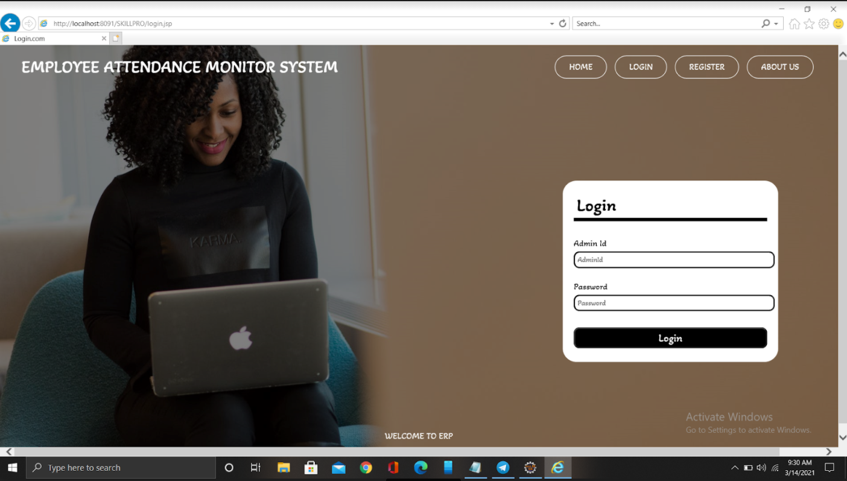
Modules Description
1. Admin Login:
In this employee attendance monitoring system, login admin generally requires the user to enter two pieces of
information, first a username and then a password.
After logging in, the admin users are redirected to the
admin Pages

Slide 6
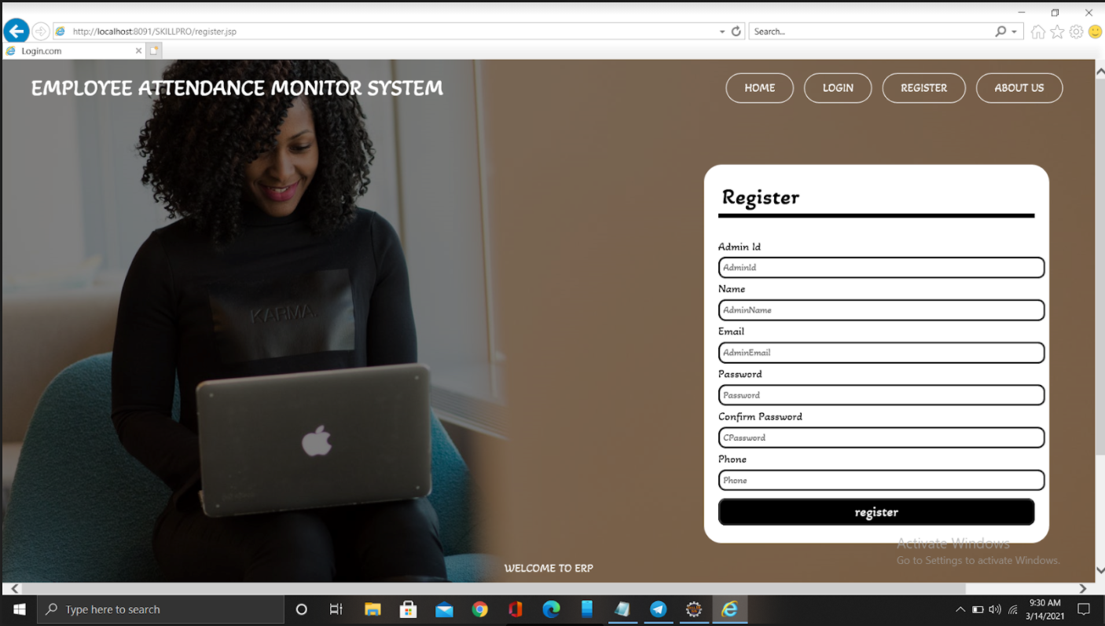
Module Description
2. Admin Registration:
In this employee attendance monitoring system,Employees are
able to register on any courses . Registration can be done by
some admin credentials such as Adminid, name, Email,
password, confirm password, phone to get registered.

Slide 7
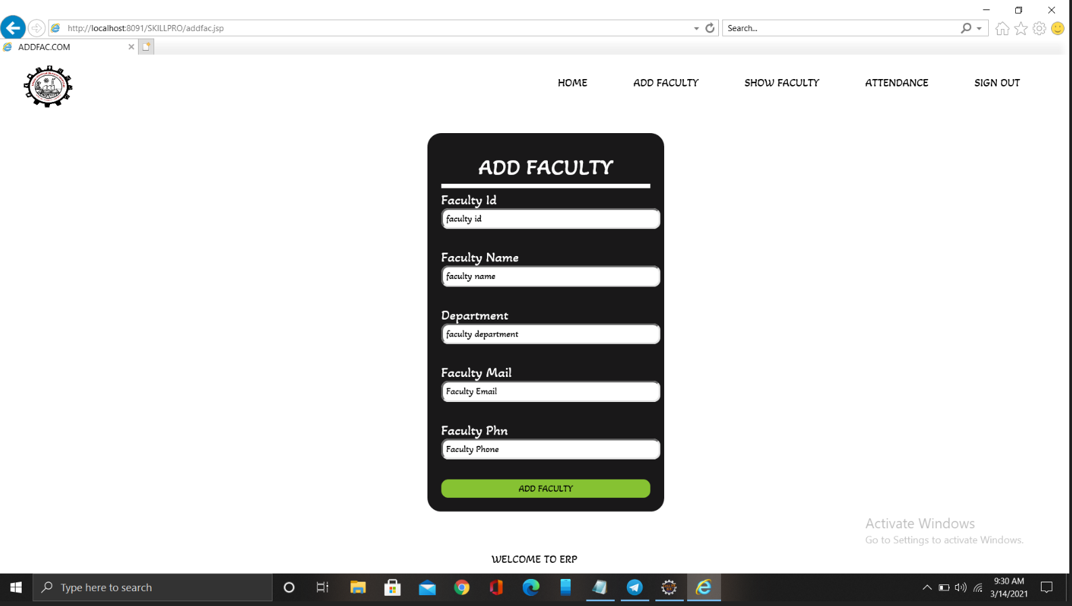
Module Description
3. CRUD Operation:
Adding Faculty: This module is used to add faculty members in form of table.
And we will add the same in the database. In this module
We will add faculty by using some credentials like faculty id,
Faculty name, department,faculty email,faculty plan.

Slide 8
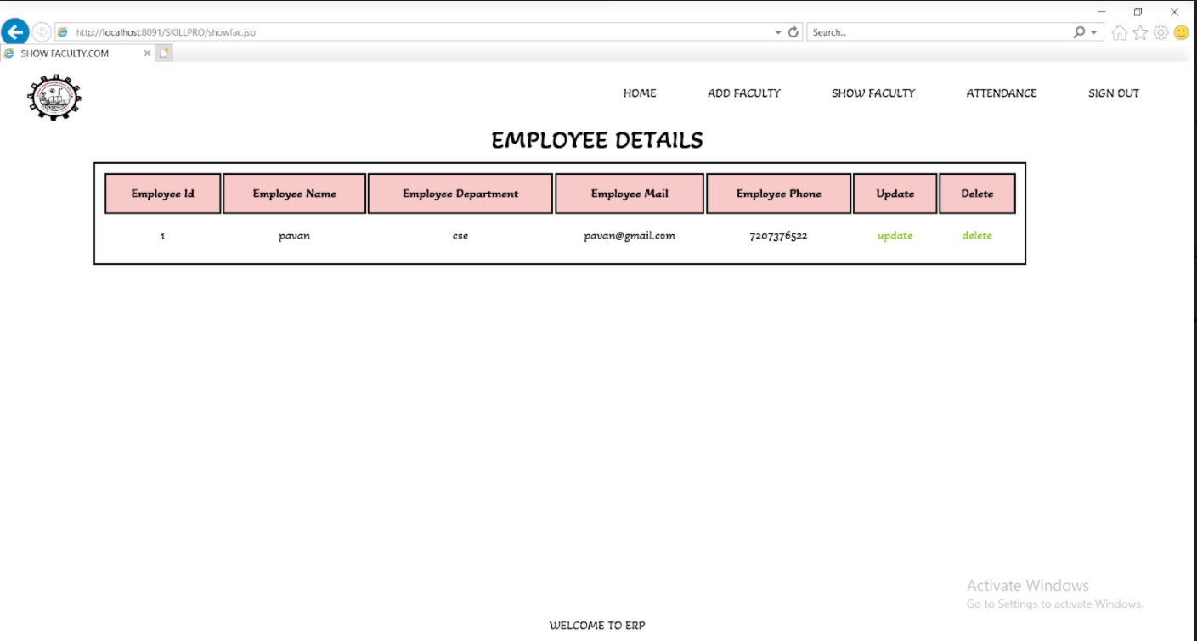
Module Description
2. Deleting Faculty:
In this type of module we can able to delete any of the details in the given credentials. We can delete previous add details such as Employee id,employee name, employee email, employee dept,employee phone.

Slide 9
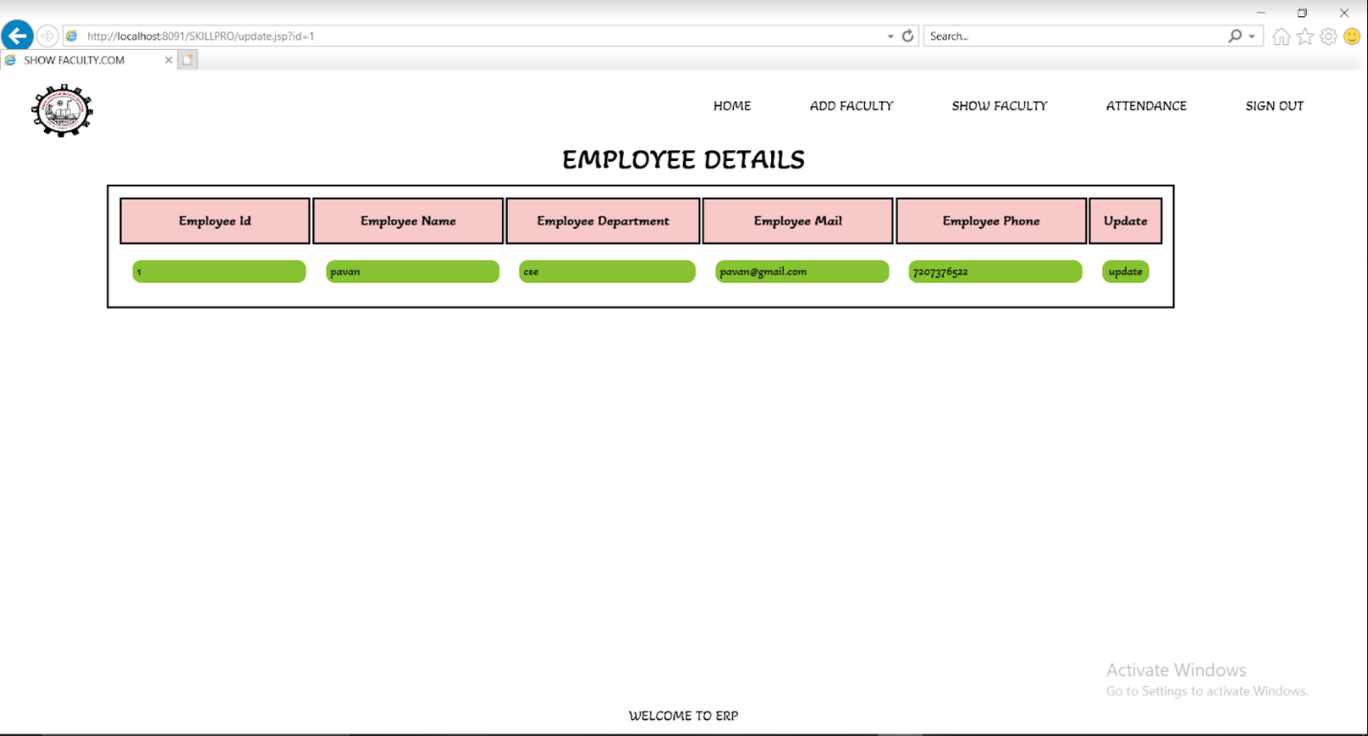
Module Description
3. Updating Faculty:
In this type of module we are just removing old values and Placing new values that is updating. We are able to update Employee id, employee name, employee department , Employee email, employee phone.

Slide 10
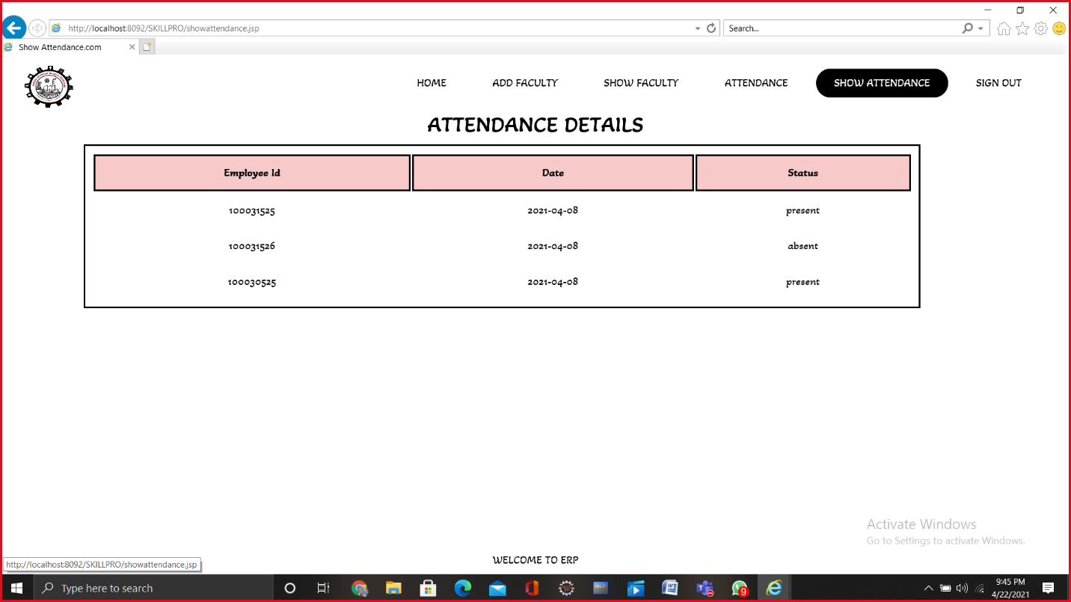
Module Description
4. Show Faculty:
It will show attendance of added faculty.

Slide 11
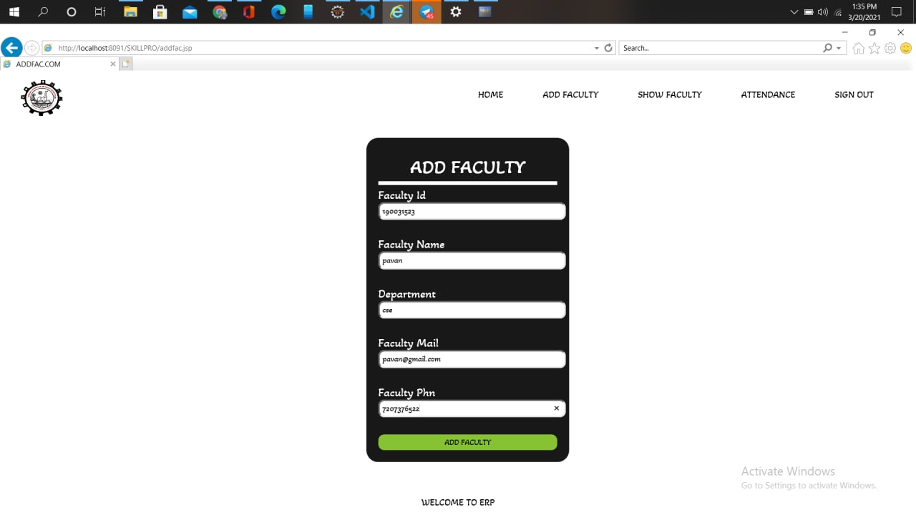
Testing Approaches

Slide 12
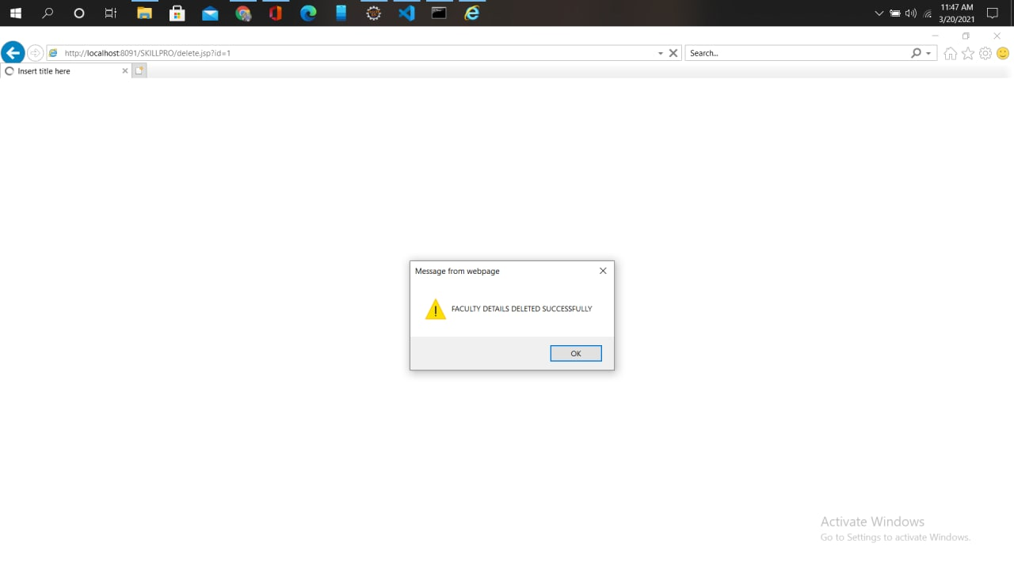
Testing Approaches

Slide 13
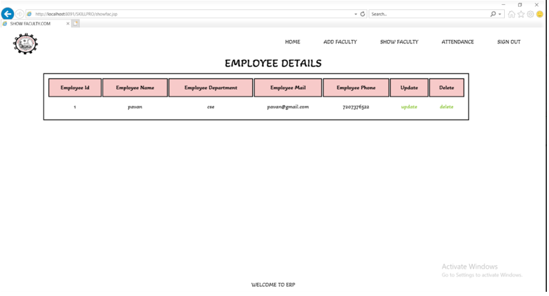
Testing Approaches

Slide 14
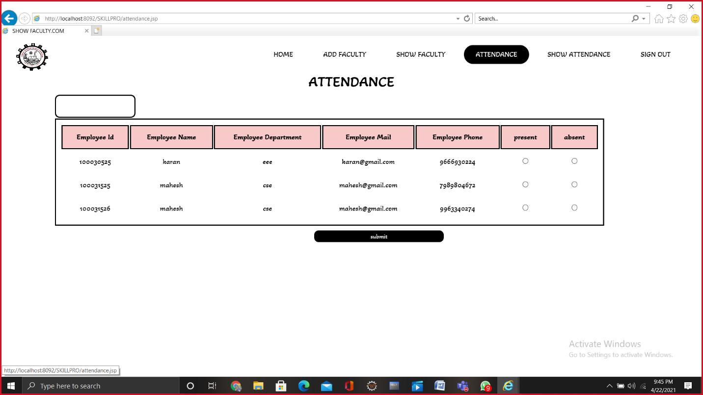
Testing Approaches

Slide 15
Testing Approaches

Slide 16
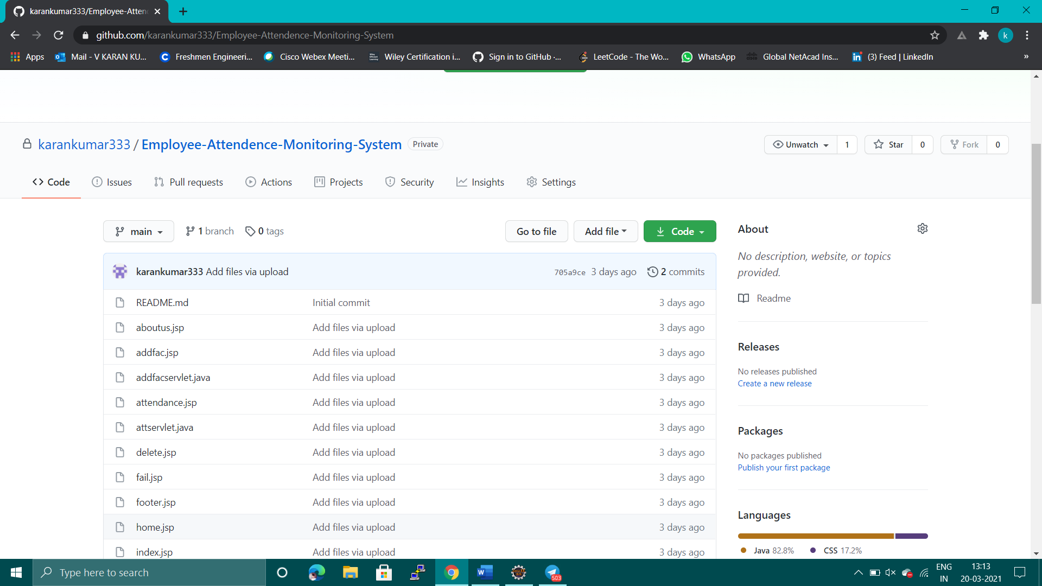
Deployment details in any of the open source clouds (GitHub):

Slide 17
Teamates
190031523 – S Pavan Kumar
190031664 – V Karan Kumar
190031901 – P Teja Venkata Poorna Kumarr

Slide 18
Thank You

